Slide 1

What is bad code
Fragile : Fragility is closely related to rigidity, but refers to software that tends to break in many places every time it is changed, even in areas that are conceptually unrelated.
Rigid : This refers to code being difficult to change. Code is tightly coupled.
Immobility : Refers to the inability to reuse software from other parts of the system.
Viscosity : Viscosity is the resistance against making a change. From a design point of view, whenever we need to make a change we think it through and solve it the right way, or we can find a quick and dirty hack.

Slide 2
S.O.L.I.D. Principles
SRP: Single Responsibility Principle
OCP: Open Closed Principle
LSP: Liskov Substitution Principle
ISP: Interface Segregation Principle
DIP: Dependency Inversion Principle

Slide 3
Working on a email sender app, journey before and after
Example App: Before And After
IMessageInfo
Retriever
IEmailSender
Email Sending App
EmailProcessingService
Flat File
Database
Database
Reader
Service
IMessage
Info
Retriever
File
XML File
IFileFormat Reader
FileReader
Service
EmailService
IEmail
Service
Before
After

Slide 4
The Single Responsibility Principle

Slide 5
SRP: The Single Responsibility Principle
The Single Responsibility Principle states that every object should have a single responsibility, and that responsibility should be entirely encapsulated by the class.
Wikipedia
There should never be more than one reason for a class to change.
Robert C. “Uncle Bob” Martin

Slide 6
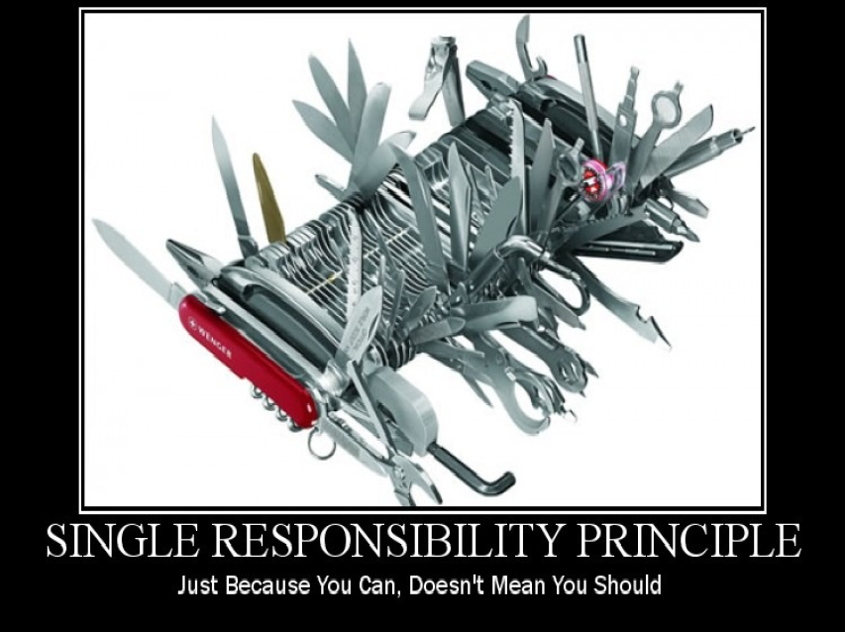

Slide 7
Cohesion and Coupling
Cohesion: how strongly-related and focused are the various responsibilities of a module
Coupling: the degree to which each program module relies on each one of the other modules
Strive for low coupling and high cohesion!

Slide 8
Responsibilities are Axes of Change
Requirements changes typically map to responsibilities
More responsibilities == More likelihood of change
Having multiple responsibilities within a class couples together these responsibilities
The more classes a change affects, the more likely the change will introduce errors.

Slide 9
Demo
The Problem With Too Many Responsibilities

Slide 10
What is a Responsibility?
“a reason to change”
A difference in usage scenarios from the client’s perspective
Multiple small interfaces (follow ISP) can help to achieve SRP

Slide 11
SRP: Single Responsibility
Example App: Read A Flat File And Send An Email
Email Sending App
File

Slide 12
SRP: Single Responsibility
Email Sending App
Example App New Requirements: Send From Non-WinForms App. Read XML Or Flat File
Email Sender
Flat File
XML File

Slide 13
Example App: A Better Structure
Email Sender
Format Reader
Flat File
XML File

Slide 14
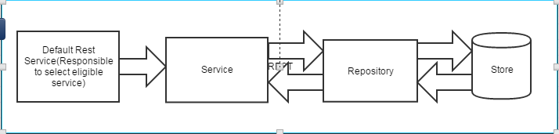
A High Level View of our rest service

Slide 15
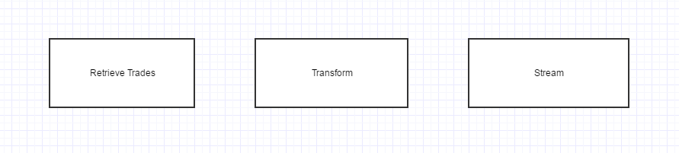
Responsiblities holded by Repository Implementer

Slide 16
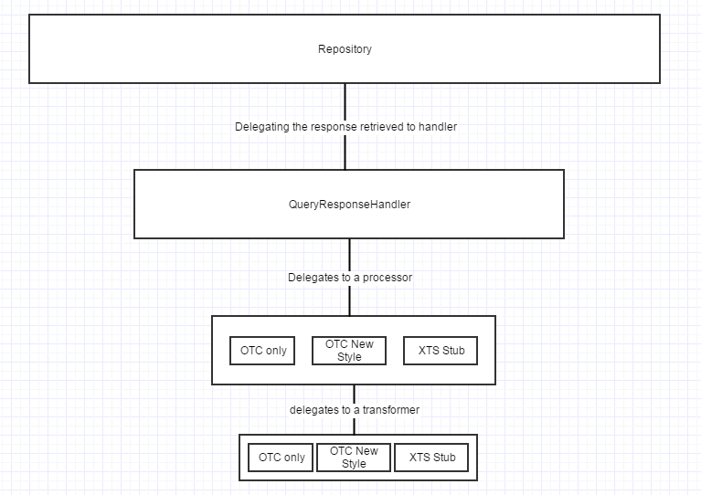
Architecture post applying single responsibility principle

Slide 17
Summary
Following SRP leads to lower coupling and higher cohesion
Many small classes with distinct responsibilities result in a more flexible design
Related Fundamentals:
Open/Closed Principle
Interface Segregation Principle
Separation of Concerns
Recommended Reading:
Clean Code by Robert C. Martin [http://amzn.to/Clean-Code]

Slide 18
The Open / Closed Principle

Slide 19
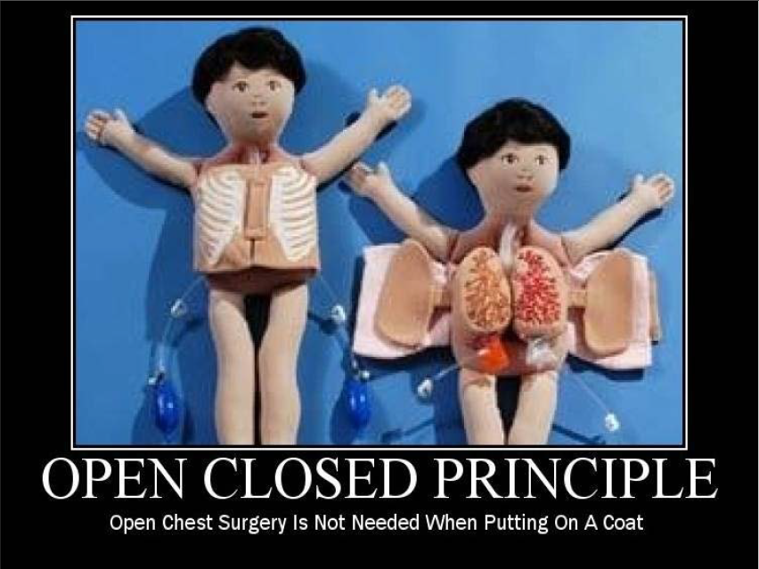

Slide 20
OCP: The Open/Closed Principle
The Open / Closed Principle states that software entities (classes, modules, functions, etc.) should be open for extension, but closed for modification
Wikipedia

Slide 21
The Open / Closed Principle
Open to Extension
New behavior can be added in the future
Closed to Modification
Changes to source or binary code are not required
Dr. Bertrand Meyer originated the OCP term in his 1988 book, Object Oriented Software Construction

Slide 22
Change behavior without changing code?
Rely on abstractions
No limit to variety of implementations of each abstraction
In .NET, abstractions include:
Interfaces
Abstract Base Classes
In procedural code, some level of OCP can be achieved via parameters

Slide 23
The Problem
Adding new rules require changes to the calculator every time
Each change can introduce bugs and requires re-testing, etc.
We want to avoid introducing changes that cascade through many modules in our application
Writing new classes is less likely to introduce problems
Nothing depends on new classes (yet)
New classes have no legacy coupling to make them hard to design or test

Slide 24
Three Approaches to Achieve OCP
Parameters (Procedural Programming)
Allow client to control behavior specifics via a parameter
Combined with delegates/lambda, can be very powerful approach
Inheritance / Template Method Pattern
Child types override behavior of a base class (or interface)
Composition / Strategy Pattern
Client code depends on abstraction
Provides a “plug in” model
Implementations utilize Inheritance; Client utilizes Composition

Slide 25
When do we apply OCP?
Experience Tells You
If you know from your own experience in the problem domain that a particular class of change is likely to recur, you can apply OCP up front in your design
Otherwise – “Fool me once, shame on you; fool me twice, shame on me”
Don’t apply OCP at first
If the module changes once, accept it.
If it changes a second time, refactor to achieve OCP
Remember TANSTAAFL
There Ain’t No Such Thing As A Free Lunch
OCP adds complexity to design
No design can be closed against all changes

Slide 26
Summary
Conformance to OCP yields flexibility, reusability, and maintainability
Know which changes to guard against, and resist premature abstraction
Related Fundamentals:
Single Responsibility Principle
Strategy Pattern
Template Method Pattern
Recommended Reading:
Agile Principles, Patterns, and Practices by Robert C. Martin and Micah Martin [http://amzn.to/agilepppcsharp]

Slide 27
The Liskov Substitution Principle

Slide 28
LSP: The Liskov Substitution Principle
The Liskov Substitution Principle states that Subtypes must be substitutable for their base types.
Agile Principles, Patterns, and Practices in C#
Named for Barbara Liskov, who first described the principle in 1988.

Slide 29
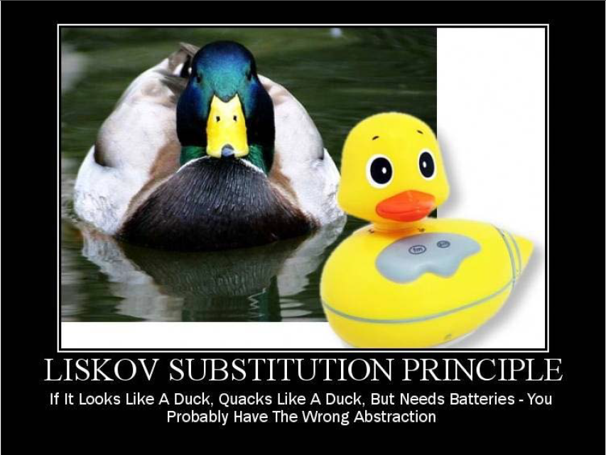

Slide 30
Substitutability
Child classes must not:
Remove base class behavior
Violate base class invariants
And in general must not require calling code to know they are different from their base type.

Slide 31
Inheritance and the IS-A Relationship
Naïve OOP teaches use of IS-A to describe child classes’ relationship to base classes
LSP suggests that IS-A should be replaced with
IS-SUBSTITUTABLE-FOR

Slide 32
LSP: Liskov Substitution Principle
Example App: Violating LSP with Database Connection Info
Database
FileReader
Service
Email Sender
IFileFormat Reader
Flat File
XML File
Database Connection File

Slide 33
LSP: Liskov Substitution Principle
Example App: Correcting For LSP – Move The Database Reader
Database
Database
Reader
Service
Flat File
Email Sender
IFileFormat Reader
FileReader
Service
XML File

Slide 34
Invariants
Consist of reasonable assumptions of behavior by clients
Can be expressed as preconditions and postconditions for methods
Frequently, unit tests are used to specify expected behavior of a method or class
Design By Contract is a technique that makes defining these pre- and post-conditions explicit within code itself.
To follow LSP, derived classes must not violate any constraints defined (or assumed by clients) on the base classes

Slide 35
The Problem
Non-substitutable code breaks polymorphism
Client code expects child classes to work in place of their base classes
“Fixing” substitutability problems by adding if-then or switch statements quickly becomes a maintenance nightmare (and violates OCP)

Slide 36
LSP Violation “Smells”
foreach (var emp in Employees)
{
if( emp is Manager )
{
_printer.PrintManager( emp as Manager );
}
else
{
_printer.PrintEmployee( emp );
}
}

Slide 37
LSP Violation “Smells”
public abstract class Base
{
public abstract void Method1();
public abstract void Method2();
}
public class Child : Base
{
public override void Method1()
{
throw new NotImplementedException();
}
public override void Method2()
{
// do stuff
}
}
Follow ISP!
Use small interfaces so you don’t require classes to implement more than they need!

Slide 38
When do we fix LSP?
If you notice obvious smells like those shown
If you find yourself being bitten by the OCP violations LSP invariably causes

Slide 39
LSP Tips
“Tell, Don’t Ask”
Don’t interrogate objects for their internals – move behavior to the object
Tell the object what you want it to do
Consider Refactoring to a new Base Class
Given two classes that share a lot of behavior but are not substitutable…
Create a third class that both can derive from
Ensure substitutability is retained between each class and the new base

Slide 40
Summary
Conformance to LSP allows for proper use of polymorphism and produces more maintainable code
Remember IS-SUBSTITUTABLE-FOR instead of IS-A
Related Fundamentals:
Polymorphism
Inheritance
Interface Segregation Principle
Open / Closed Principle
Recommended Reading:
Agile Principles, Patterns, and Practices by Robert C. Martin and Micah Martin [http://amzn.to/agilepppcsharp]

Slide 41
The Interface Segregation Principle

Slide 42
ISP: The Interface Segregation Principle
The Interface Segregation Principle states that Clients should not be forced to depend on methods they do not use.
Agile Principles, Patterns, and Practices in C#
Corollary:
Prefer small, cohesive interfaces to “fat” interfaces

Slide 43
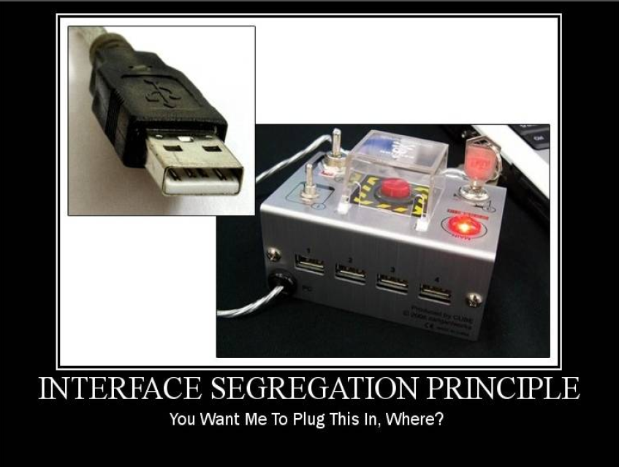

Slide 44
What’s an Interface?
Interface keyword/type
public interface IDoSomething { … }
Public interface of a class
public class SomeClass { … }
What does the client see and use?

Slide 45
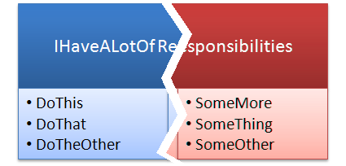
ISP: Interface Segregation Principle
“This principle deals with the disadvantages of ‘fat’ interfaces. Classes that have ‘fat’ interfaces are classes whose interfaces are not cohesive. In other words, the interfaces of the class can be broken up into groups of member functions. Each group serves a different set of clients. Thus some clients use one group of member functions, and other clients use the other groups.”
- Robert Martin

Slide 46
Demo
Violating ISP

Slide 47
ISP: Interface Segregation Principle
Example App: Clarifying The Email Sender and Message Info Parsing
EmailSender
EmailSender
Database Reader
Service
SendEmail
ReadFile
ReadFromDb
SendEmail
GetMessageBody
FileReader
Service
GetMessageBody

Slide 48
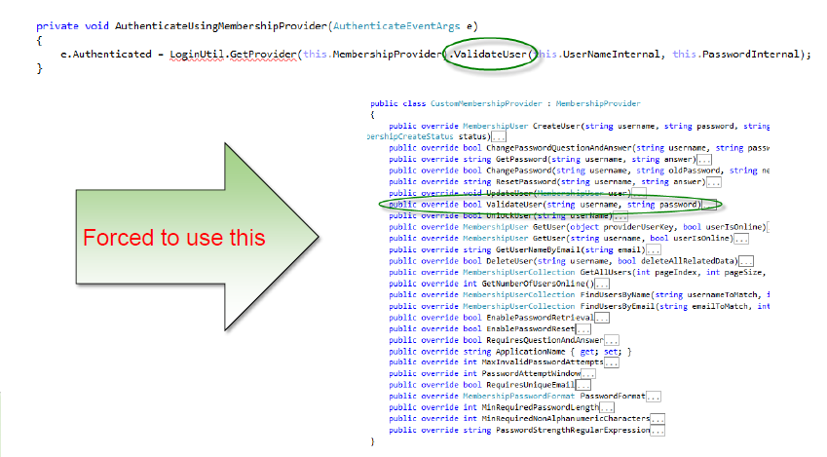
The Problem
Client Class (Login Control) Needs This:

Slide 49
The Problem
AboutPage simply needs ApplicationName and AuthorName
Forced to deal with huge ConfigurationSettings class
Forced to deal with actual configuration files
Interface Segregation violations result in classes that depend on things they do not need, increasing coupling and reducing flexibility and maintainability

Slide 50
ISP Smells
Unimplemented interface methods:
public override string ResetPassword(
string username, string answer)
{
throw new NotImplementedException();
}
Remember these violate Liskov Substitution Principle!

Slide 51
ISP Smells
Client references a class but only uses small portion of it

Slide 52
When do we fix ISP?
Once there is pain
If there is no pain, there’s no problem to address.
If you find yourself depending on a “fat” interface you own
Create a smaller interface with just what you need
Have the fat interface implement your new interface
Reference the new interface with your code
If you find “fat” interfaces are problematic but you do not own them
Create a smaller interface with just what you need
Implement this interface using an Adapter that implements the full interface

Slide 53
ISP Tips
Keep interfaces small, cohesive, and focused
Whenever possible, let the client define the interface
Whenever possible, package the interface with the client
Alternately, package in a third assembly client and implementation both depend upon
Last resort: Package interfaces with their implementation

Slide 54
Summary
Don’t force client code to depend on things it doesn’t need
Keep interfaces lean and focused
Refactor large interfaces so they inherit smaller interfaces
Related Fundamentals:
Polymorphism
Inheritance
Liskov Substitution Principle
Façade Pattern
Recommended Reading:
Agile Principles, Patterns, and Practices by Robert C. Martin and Micah Martin [http://amzn.to/agilepppcsharp]

Slide 55
The Dependency Inversion Principle

Slide 56
DIP: Dependency Inversion Principle
“What is it that makes a design rigid, fragile and immobile? It is the interdependence of the modules within that design. A design is rigid if it cannot be easily changed. Such rigidity is due to the fact that a single change to heavily interdependent software begins a cascade of changes in dependent modules.”
- Robert Martin
Dependency
Depender

Slide 57
DIP: The Dependency Inversion Principle
High-level modules should not depend on low-level modules. Both should depend on abstractions.
Abstractions should not depend on details. Details should depend on abstractions.
Agile Principles, Patterns, and Practices in C#

Slide 58
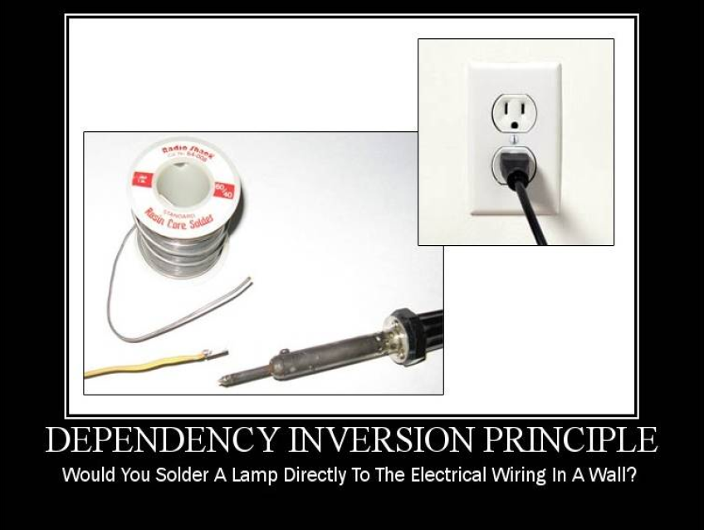

Slide 59
DIP: Dependency Inversion Principle
ThisClass
ThatClass
AnotherClass

Slide 60
DIP: Dependency Inversion Principle
IDoSomething
ThisClass
IWhatever
ThatClass
AnotherClass

Slide 61
DIP: Dependency Inversion Principle
IDoSomething
IWhatever
ThisClass
ThatClass
IDoSomething
AnotherClass
IWhatever

Slide 62
DIP: Dependency Inversion Principle
AnotherClass
IWhatever
IWhatever
ThatClass
IDoSomething
IDoSomething
ThisClass

Slide 63
DIP: Dependency Inversion Principle
Example App: Constructor Dependencies in a Processing Service
Xml File Reader
Flat File Reader
IFileFormat Reader
Database Reader Service
File Reader Service
Email Sender
IMessageInfoRetriever
IEmailService
ProcessingService

Slide 64
What are dependencies?
Framework
Third Party Libraries
Database
File System
Email
Web Services
System Resources (Clock)
Configuration
The new Keyword
Static methods
Thread.Sleep
Random

Slide 65
Traditional Programming and Dependencies
High Level Modules Call Low Level Modules
User Interface depends on
Business Logic depends on
Infrastructure
Utility
Data Access
Static methods are used for convenience or as Façade layers
Class instantiation / Call stack logic is scattered through all modules
Violation of Single Responsibility Principle

Slide 66
Class Dependencies: Be Honest!
Class constructors should require any dependencies the class needs
Classes whose constructors make this clear have explicit dependencies
Classes that do not have implicit, hidden dependencies
public class HelloWorldHidden
{
public string Hello(string name)
{
if (DateTime.Now.Hour < 12) return "Good morning, " + name; if (DateTime.Now.Hour < 18) return "Good afternoon, " + name; return "Good evening, " + name;
}
}

Slide 67
Classes Should Declare What They Need
public class HelloWorldExplicit
{
private readonly DateTime _timeOfGreeting;
public HelloWorldExplicit(DateTime timeOfGreeting)
{
_timeOfGreeting = timeOfGreeting;
}
public string Hello(string name)
{
if (_timeOfGreeting.Hour < 12) return "Good morning, " + name;
if (_timeOfGreeting.Hour < 18) return "Good afternoon, " + name;
return "Good evening, " + name;
}
}

Slide 68
The Problem
Order has hidden dependencies:
MailMessage
SmtpClient
InventorySystem
PaymentGateway
Logger
DateTime.Now
Result
Tight coupling
No way to change implementation details (OCP violation)
Difficult to test

Slide 69
Dependency Injection
Dependency Injection is a technique that is used to allow calling code to inject the dependencies a class needs when it is instantiated.
The Hollywood Principle
“Don’t call us; we’ll call you”
Three Primary Techniques
Constructor Injection
Property Injection
Parameter Injection
Other methods exist as well

Slide 70
Constructor Injection
Dependencies are passed in via constructor
Strategy Pattern
Pros
Classes self-document what they need to perform their work
Works well with or without a container
Classes are always in a valid state once constructed
Cons
Constructors can have many parameters/dependencies (design smell)
Some features (e.g. Serialization) may require a default constructor
Some methods in the class may not require things other methods require (design smell)

Slide 71
Property Injection
Dependencies are passed in via a property
Also known as “setter injection”
Pros
Dependency can be changed at any time during object lifetime
Very flexible
Cons
Objects may be in an invalid state between construction and setting of dependencies via setters
Less intuitive

Slide 72
Parameter Injection
Dependencies are passed in via a method parameter
Pros
Most granular
Very flexible
Requires no change to rest of class
Cons
Breaks method signature
Can result in many parameters (design smell)
Consider if only one method has the dependency, otherwise prefer constructor injection

Slide 73
Refactoring
Extract Dependencies into Interfaces
Inject implementations of interfaces into Order
Reduce Order’s responsibilities (apply SRP)

Slide 74
DIP Smells
Use of new keyword
foreach(var item in cart.Items)
{
try
{
var inventorySystem = new InventorySystem();
inventorySystem.Reserve(item.Sku, item.Quantity);
}
}

Slide 75
DIP Smells
Use of static methods/properties
message.Subject = "Your order placed on " + DateTime.Now.ToString();
Or
DataAccess.SaveCustomer(myCustomer);

Slide 76
Where do we instantiate objects?
Applying Dependency Injection typically results in many interfaces that eventually need to be instantiated somewhere… but where?
Default Constructor
You can provide a default constructor that news up the instances you expect to typically need in your application
Referred to as “poor man’s dependency injection” or “poor man’s IoC”
Main
You can manually instantiate whatever is needed in your application’s startup routine or main() method
IoC Container
Use an “Inversion of Control” Container

Slide 77
IoC Containers
Responsible for object graph instantiation
Initiated at application startup via code or configuration
Managed interfaces and the implementation to be used are Registered with the container
Dependencies on interfaces are Resolved at application startup or runtime
Examples of IoC Containers for .NET
Microsoft Unity
StructureMap
Ninject
Windsor
Funq / Munq

Slide 78
Summary
Depend on abstractions.
Don’t force high-level modules to depend on low-level modules through direct instantiation or static method calls
Declare class dependencies explicitly in their constructors
Inject dependencies via constructor, property, or parameter injection
Related Fundamentals:
Single Responsibility Principle
Interface Segregation Principle
Façade Pattern
Inversion of Control Containers
Recommended Reading:
Agile Principles, Patterns, and Practices by Robert C. Martin and Micah Martin [http://amzn.to/agilepppcsharp]
http://www.martinfowler.com/articles/injection.html

Slide 79
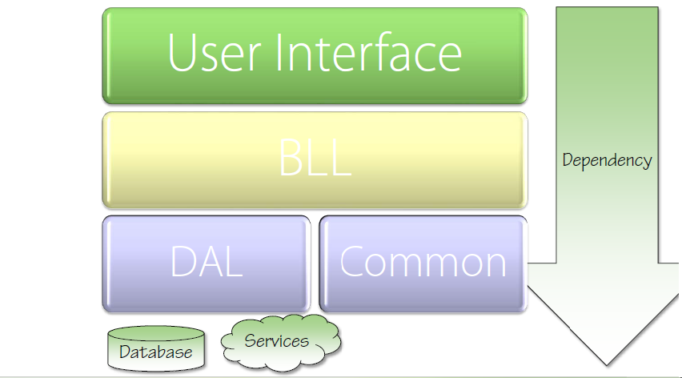
Traditional (Naïve) Layered Architecture

Slide 80
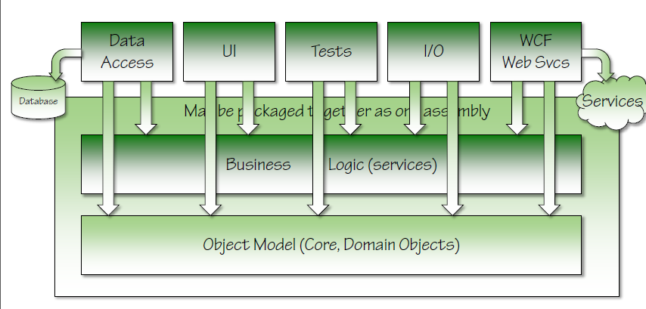
Inverted Architecture

Slide 81
The Problem
Dependencies Flow Toward Infrastructure
Core / Business / Domain Classes Depend on Implementation Details
Result
Tight coupling
No way to change implementation details without recompile (OCP violation)
Difficult to test

Slide 82
Dependency Injection
Dependency is transitive
If UI depends on BLL depends on DAL depends on Database Then *everything* depends on the Database
Depend on abstractions (DIP)
Package interfaces (abstractions) with the client (ISP)
Structure Solutions and Projects so Core / BLL is at center, with fewest dependencies

Slide 83
Summary
Don’t Depend on Infrastructure Assemblies from Core
Apply DIP to reverse dependencies
Related Fundamentals:
Open Closed Principle
Interface Segregation Principle
Strategy Pattern
Recommended Reading:
Agile Principles, Patterns, and Practices by Robert C. Martin and Micah Martin [http://amzn.to/agilepppcsharp]
http://www.martinfowler.com/articles/injection.html

Slide 84
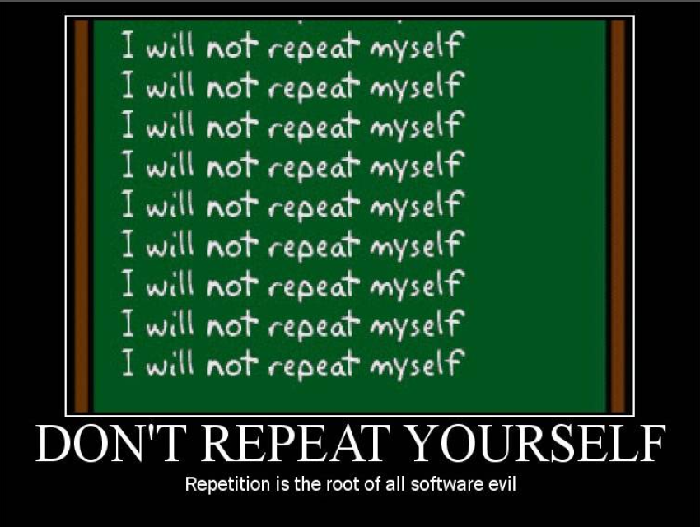

Slide 85
Don’t Repeat Yourself
“Every piece of knowledge must have a single, unambiguous representation in the system.”
The Pragmatic Programmer
“Repetition in logic calls for abstraction. Repetition in process calls for automation.”
97 Things Every Programmer Should Know
Variations include:
Once and Only Once
Duplication Is Evil (DIE)

Slide 86
Analysis
Magic Strings/Values
Duplicate logic in multiple locations
Repeated if-then logic
Conditionals instead of polymorphism
Repeated Execution Patterns
Lots of duplicate, probably copy-pasted, code
Only manual tests
Static methods everywhere

Slide 87
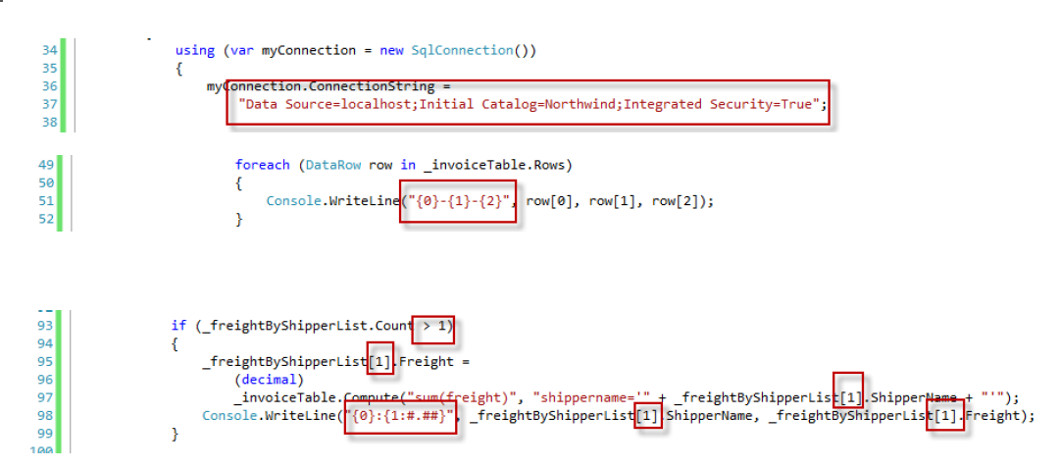
Magic Strings / Values

Slide 88
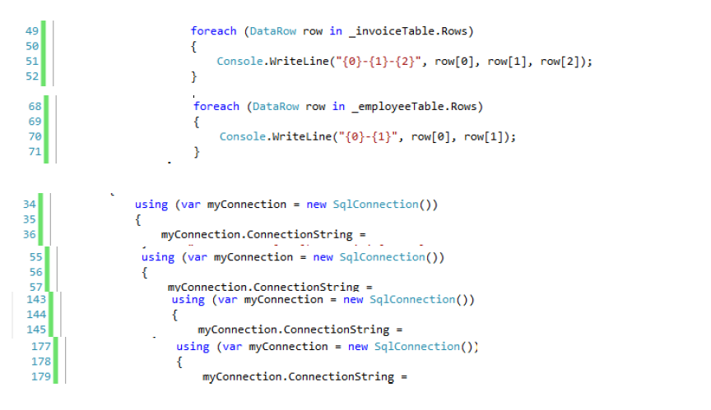
Duplicate Logic in Multiple Locations

Slide 89
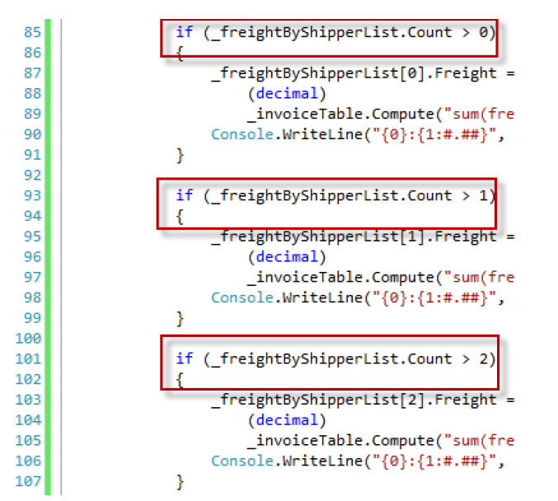
Repeated if-then Logic

Slide 90
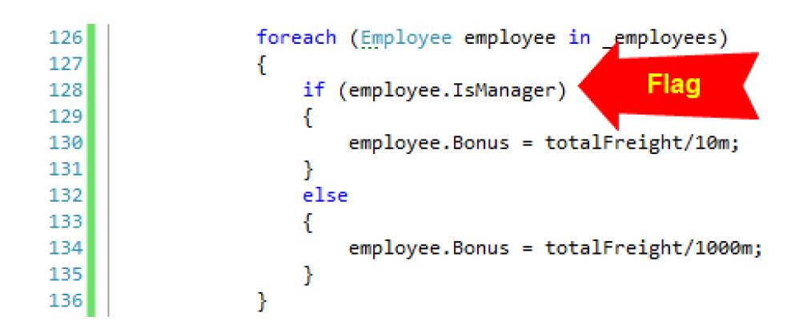
Conditional Instead of Polymorphism
Example of Flags Over Objects anti-pattern
Violates the Tell, Don’t Ask principle (aka DIP)

Slide 91
Summary
Repetition breeds errors and waste
Refactor code to remove repetition
Recommended Reading:
The Pragmatic Programmer: From Journeyman to Master http://amzn.to/b2gJdK
97 Things Every Programmer Should Know http://amzn.to/cAse1Y

Slide 92
Static Methods
Tightly coupled
Difficult to test
Difficult to change behavior (violates OCP)
Cannot use object oriented design techniques
Inheritance
Polymorphism

Slide 93
Summary
Repetition breeds errors and waste
Abstract repetitive logic in code
Related Fundamentals:
Template Method Pattern
Command Pattern
Dependency Inversion Principle
Recommended Reading:
The Pragmatic Programmer: From Journeyman to Master http://amzn.to/b2gJdK
97 Things Every Programmer Should Know http://amzn.to/cAse1Y

Slide 94
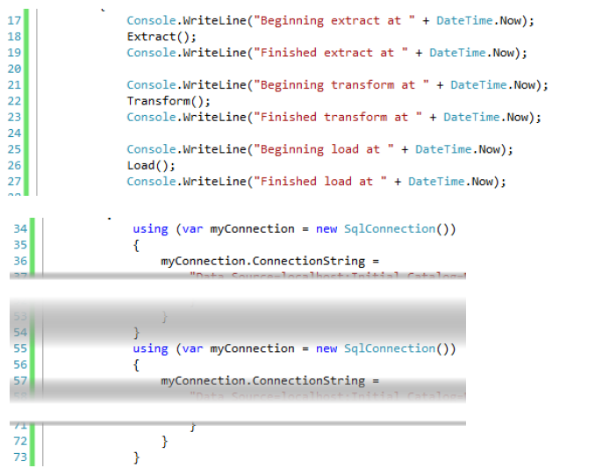
Repeated Execution Patterns

Slide 95
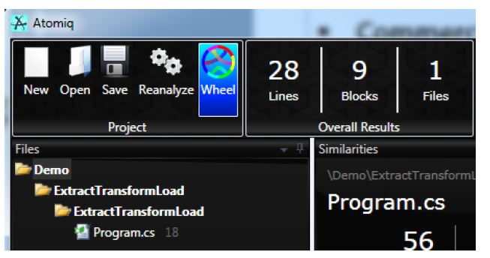
Duplicate, Copy Pasted Code
Too Numerous to List
Commercial Tool (free version available)
Atomiq (http://GetAtomiq.com)

Slide 96
Consider Code Generation
T4 Templates
Custom code generation templates
Built into Visual Studio 2010
ORM Tools (LINQ to SQL, Entity Framework, nHibernate, LLBLGen)
Reduce repetitive data access code
Eliminate common data access errors
Commercial Tools:
CodeSmith
CodeBreeze
CodeHayStack

Slide 97
Repetition in Process
Testing
Performing testing by hand is tedious and wasteful
Builds
Performing builds by hand is tedious and wasteful
Deployments
Performing deployments by hand is tedious and wasteful
Are you seeing a trend here?
String.Format(“Performing {0} by hand is tedious and wasteful”, action);

Slide 98
Summary
Repetition breeds errors and waste
Use an ORM tool to eliminate repeated data access code
Use Tools to Locate Repeated Code
Automate repetitive actions in your processes
Recommended Reading:
The Pragmatic Programmer: From Journeyman to Master http://amzn.to/b2gJdK
97 Things Every Programmer Should Know http://amzn.to/cAse1Y
Related Tool
Atomiq http://GetAtomiq.com

Slide 99
S.O.L.I.D. Conversion Summary
Example App: Before And After
IMessageInfo
Retriever
IEmailSender
Email Sending App
EmailProcessingService
Flat File
Database
Database
Reader
Service
IMessage
Info
Retriever
File
XML File
IFileFormat Reader
FileReader
Service
EmailService
IEmail
Service
Before
After

Slide 100
S.O.L.I.D. -> OO Principles
Low Coupling: OCP, DIP, ISP
IMessageInfo
Retriever
IEmailSender
EmailProcessingService
Flat File
Database
Database
Reader
Service
IMessage
Info
Retriever
XML File
IFileFormat Reader
FileReader
Service
EmailService
IEmail
Service

Slide 101
S.O.L.I.D. -> OO Principles
High Cohesion: Low Coupling + SRP, LSP
IMessageInfo
Retriever
IEmailSender
EmailProcessingService
Flat File
Database
Database
Reader
Service
IMessage
Info
Retriever
XML File
IFileFormat Reader
FileReader
Service
EmailService
IEmail
Service

Slide 102
S.O.L.I.D. -> OO Principles
Encapsulation: SRP, LSP, DIP
IMessageInfo
Retriever
IEmailSender
EmailProcessingService
Flat File
Database
Database
Reader
Service
IMessage
Info
Retriever
XML File
IFileFormat Reader
FileReader
Service
EmailService
IEmail
Service

Slide 103
Questions?

Slide 104
Thank You!
Adnan Masood
adnanmasood@acm.org @adnanmasood
Blog: blog.AdnanMasood.com
Pasadena .NET User Group: www.sgvdotnet.org

